Slide 1



Lecture 1: Module Introduction
GAM320: Major Game Development Project: Pre-Production

Slide 2
Module Aims
“To carry out the pre-production of a market-viable digital game.”
More broadly
work in a multi-skilled team and start work on a project that you will continue to develop throughout the year
You will build upon your learning experience from the prior stages of the course to develop your skills
With formative feedback from your tutors, you begin to build your game using Agile and iterative methods

Slide 3
Module Roadmap
Week 1 | Week 2 | Week 3 | Week 4 | Week 5 | Week 6
Introduction | Synchronous workshop | Asynchronous Lecture | Synchronous workshop | Asynchronous Lecture
Supervisor Meeting | Supervisor Meeting + Crit | Supervisor Meeting | Supervisor Meeting | Supervisor Meeting | Green Light Process
Week 7 | Week 8 | Week 9 | Week 10 | Week 11 | Week 12
Synchronous workshop | Asynchronous Lecture | Synchronous workshop | Asynchronous Lecture | Synchronous workshop | Asynchronous Lecture
Supervisor Meeting | Supervisor Meeting | Supervisor Meeting | Supervisor Meeting + Crit | Supervisor Meeting | Supervisor Meeting
Week 13
Demo Day

Slide 4
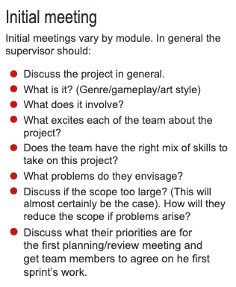
1st Supervisor Meeting

Slide 5
Last Years Examples 1

Slide 6

Last Years Examples 2

Slide 7

Last Years Examples 3

Slide 8
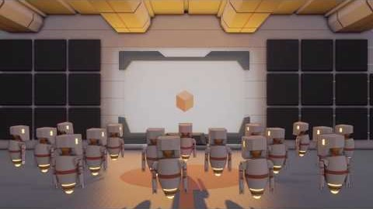
Last Years Examples 4

Slide 9

Last Years Examples 5

Slide 10
What is Pre-Production – Film 1
Pre-production is the period of time used to plan and prepare for the shooting and completion of your film.
The Complete Film Production Handbook

Slide 11
What is Pre-Production – Film 2
This crucial step defines how efficient, organized and, ultimately, how successful the production stage will be.
Is the planning process and execution of every task that must take place before production begins.
https://www.studiobinder.com/blog/what-is-pre-production-definition/

Slide 12
What is Pre-Production – Games 1
Pre-Production is the ‘chaotic first phase where the game design takes form’
Output: 1st Playable, Macro Design
Cerny “Method” talk at DICE2002

Slide 13
What is Pre-Production – Games 2
Verify the feasibility of the idea
Focusing on proving out different features and risky technology
Output: 1 Playable level or environment
Game Design Workshop Chapter 13 Pg426 - 427

Slide 14
Tuckman's stages of group development

Slide 15
Resources 1
Cerny Method
https://www.youtube.com/watch?v=QOAW9ioWAvE
Pre-production of Resident Evil 7
https://www.youtube.com/watch?v=gWpKYR0conM
Art of Pre-Production
https://www.youtube.com/watch?v=s2u4jhpZkTQ

Slide 16
Resources 2
Using the Stages of Team Development
https://hr.mit.edu/learning-topics/teams/articles/stages-development
Wisdom of Teams
https://falmouth.primo.exlibrisgroup.com/permalink/44FAL_INST/757rn/alma9910959143405136
Games Academy Games
https://gamesacademy.itch.io/

